Slide 1
WebGPU-Vulkan-Android Renderer
Car rendering case study
Thundersoft Japan
Tyrion Bao

Slide 2
Showcase

Slide 3
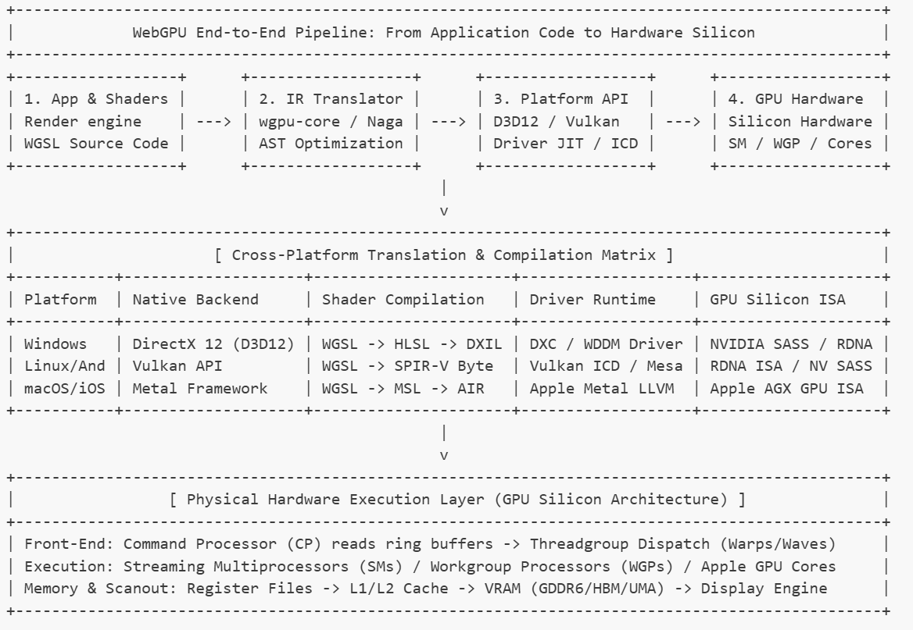
Architecture

Slide 4
Core Feature

Slide 5
Detailed Analysis by category
Visual analysis
Functional analysis
Performance analysis
AI integration analysis
Teamwork analysis

Slide 6
Teamwork analysis
One button click from blender to renderable
AI-native rendering engine

Slide 7
Other technologies help with the project
Google Antigravity IDE
MCP for blender/Blender
GLTF file format
Python
Vulkan/ WebGPU specification
Android ADB debugging
Rust

Slide 8
Personal note in the end
One of my goal is to deeply utilize AI during rendering engineering. While understanding matters from an academic viewpoint so I can perform necessary customization when necessary and provide accurate consulting services.
My career goal will lean towards low level rendering engine optimization or client-facing consulting because of my language advantage
I define myself as a render engineer who is fully capable of using unity/UE/Kanzi or build customized rendering pipeline to maximize the potential of any hardware

Slide 9
Thanks!

